Slide 1
Multi-Signal Wearable Device Platform
Architecture Overview — Technical Deep Dive
v1.0 · October 2026 · Confidential

Slide 2
Five Design Principles
1 No Patient Profile on Platform
PatientReference is session-only FHIR Patient ID. DevicePatientToken is one-way HMAC-SHA256 hash. Zero PII/PHI written to database.
2 Port & Adapter EMR Integration
IEMRGateway abstract interface. New EMR vendor = new adapter only. No platform core changes required.
3 Event-Driven Bounded Contexts
Apache Kafka for all inter-context communication. No synchronous cross-boundary calls.
4 AI-Augmented, Not AI-Dependent
LLM outputs are clinician-reviewed suggestions. No autonomous EMR writes.
5 Hyperscaler-Agnostic
AWS and Azure equivalents for every component. No proprietary lock-in.

Slide 3
5-Layer Reference Architecture
Layer | Name | Components
Layer 1 | Device & Edge | Wearable Device → BLE/LTE → IoT Greengrass / IoT Edge → packet validation
Layer 2 | Connectivity & Identity | Device Connectivity · Device Identity & Binding (serial# → HMAC token → PatientReference)
Layer 3 | Processing & Intelligence | Signal Processing (6-signal fusion, derived metrics, baseline) · CDS (risk scoring, anomaly detection, Claude API LLM)
Layer 4 | Domain Services | Care Coordination · Patient Engagement · Research Analytics · Population Health · Platform Observability · Audit & Compliance
Layer 5 | Integration & Access | IEMRGateway (EpicAdapter · CernerAdapter · GenericFHIRAdapter) · Platform Web App · Patient Mobile App

Slide 4
Device-to-Patient Identity: No PII Storage Problem Solved
1. Clinician launches platform via SMART on FHIR → receives FHIR PatientReference.
2. Platform creates DevicePatientBinding: SerialNumber → HMAC-SHA256(TenantID + FHIR PatientID).
3. Token stored in PostgreSQL (binding store) + Redis (active lookup cache).
4. Device transmits signal packet with SerialNumber only — no patient data on device.
5. Device Connectivity looks up token → IEMRGateway.resolve_patient_from_token() → adapter fetches Patient/{id}.
6. PatientReference used for signal pipeline — never written to database.
⬛ One active binding per SerialNumber. Token is write-once. Rebinding requires explicit revocation.

Slide 5
IEMRGateway — Vendor-Agnostic FHIR Integration
class IEMRGateway:
def get_patient_reference(self, launch_token) -> PatientReference
def resolve_patient_from_token(self, token, tenant_id) -> PatientReference
def write_observation(self, ref, obs) -> str
def write_risk_score(self, ref, assessment) -> str
def write_soap_draft(self, ref, assessment) -> str
def write_escalation_alert(self, ref, escalation) -> str
Adapter | Marketplace | Auth Method | Write Targets
EpicAdapter | Epic App Orchard | SMART on FHIR | Epic FHIR R4 + In-Basket
CernerAdapter | Cerner App Gallery | SMART on FHIR | Cerner FHIR R4 + Message Center
GenericFHIRAdapter | Per-vendor config | OAuth 2.0 / SMART | Standard FHIR R4
New EMR integration = implement IEMRGateway interface only. Zero changes to platform core services.

Slide 6
Event-Driven Architecture — Key Domain Events
Event | Raised By | Consumed By
SignalObservationRecorded | Signal Processing | CDS, Patient Engagement, Research Analytics
HypoxiaFlagRaised | Signal Processing | CDS, Care Coordination
RiskAssessmentCompleted | CDS | Care Coordination, Patient Engagement, Population Health
EscalationTriggered | Care Coordination | Patient Engagement
PatientSessionEstablished | EMR Gateway | Signal Processing, CDS
DevicePatientBindingCreated | Device Identity & Binding | EMR Gateway, Audit
DevicePatientBindingRevoked | Device Identity & Binding | EMR Gateway, Audit
RiskScoreWrittenToEMR | EMR Gateway | Audit & Compliance
DeviceOfflineDetected | Device Connectivity | Platform Observability
SLABreachTriggered | Platform Observability | Corporate Administrator

Slide 7
Core Technology Decisions
Component | Recommended | AWS Alternative | Azure Alternative
Event Bus | Apache Kafka (MSK) | Kinesis Data Streams | Azure Event Hubs
Time-Series DB | InfluxDB | AWS Timestream | Azure Data Explorer
ML Platform | MLflow + SageMaker | SageMaker Autopilot | Azure Machine Learning
LLM | Claude API (Haiku / Sonnet) | Bedrock (Claude) | Azure AI (Claude)
Identity Store | PostgreSQL + Redis | RDS + ElastiCache | Azure DB + Azure Cache
Secrets Mgmt | AWS Secrets Manager | — | Azure Key Vault
Audit Log | Kafka + S3 WORM | S3 Object Lock | ADLS Gen2 WORM
Data Lineage | OpenLineage + Marquez | — | Microsoft Purview
EMR Auth | smart-on-fhir (Python) | — | HAPI FHIR (Java)

Slide 8
6-Phase Delivery Plan
Phase | Duration | Signals | Key Deliverables
Phase 0 — Foundation | 8 wks | None | Infra, Kafka, IEMRGateway scaffold, Device Identity & Binding service, HIPAA BAA
Phase 1 — Gen 1 MVP | 12 wks | Bio-impedance + Temp | Device Connectivity, Signal Processing, threshold alerting, Patient Mobile App
Phase 2 — Gen 1 Complete | 8 wks | Bio-impedance + Temp | Baseline engine, SLA alerting, Platform Observability, Audit & Compliance, pen test
Phase 3 — Gen 2 Alpha | 12 wks | + pH + SpO₂ | CDS risk scoring, Claude API LLM, EpicAdapter, SMART on FHIR, Escalation queue
Phase 4 — Gen 2 Complete | 10 wks | + pH + SpO₂ | SOAP draft write-back, CernerAdapter, Research Analytics, clinical pilot
Phase 5 — Gen 3 | 14 wks | + H₂O₂ | Full 6-signal composite risk, oxidative stress, population ML, FDA SaMD determination

Slide 9
Top Risks & Decisions to Resolve
RISKS
OPEN DECISIONS
▸ Epic App Orchard review: 8–12 weeks — submit in Phase 0 to avoid Gen 2 delay.
Hyperscaler
AWS vs Azure — pending IT infrastructure decision.
LLM Selection
▸ SMART on FHIR token expiry during long sessions — implement refresh logic in all adapters.
Haiku (latency-optimized) vs Sonnet (quality-optimized) — define quality threshold with CDS team.
Mobile Framework
▸ Device serial number uniqueness — enforce at manufacturing + database constraint.
React Native vs Flutter for Patient Mobile App.
Service Mesh
Istio vs Linkerd for inter-service mTLS.
▸ FDA SaMD classification: engage regulatory counsel in Phase 3 planning.
Binding Expiry
Discharge event vs session end vs fixed time window.

Slide 10
Next Steps
1
Phase 0 Kickoff
Cloud provisioning, HIPAA BAA execution, Kafka cluster setup, IEMRGateway scaffold.
2
Epic App Orchard Application
Submit in Phase 0 to avoid blocking Gen 2 delivery. 8–12 week review lead time.
3
Device Identity & Binding
Finalize binding expiry policy and token revocation SLA with clinical and security teams.
4
LLM Quality Threshold
Define Haiku vs Sonnet selection criteria with CDS team — latency budget vs clinical accuracy.
5
FDA Regulatory Consultation
Initiate SaMD determination discussion in Phase 3 planning with regulatory counsel.

Slide 11
APPENDIX
Architecture Diagrams & Reference Models

Slide 12
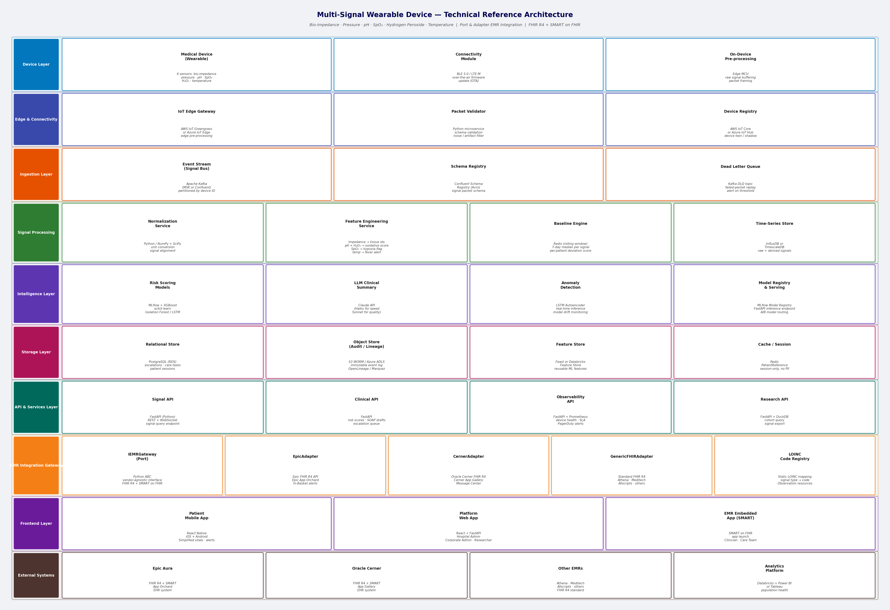
APPENDIX
Appendix A: Reference Architecture
The reference architecture organizes the platform into five horizontal layers: Device & Edge (IoT capture and transmission), Connectivity & Identity (packet ingestion and device-patient token binding), Processing & Intelligence (6-signal fusion and AI risk scoring), Domain Services (care coordination, research, observability, audit), and Integration & Access (EMR gateway, web app, mobile app). Data flows top-to-bottom; all inter-layer communication is event-driven via Apache Kafka.

Slide 13
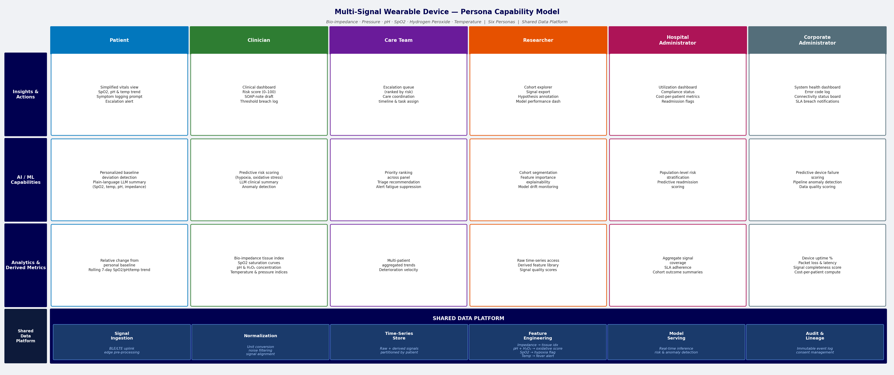
APPENDIX
Appendix B: Persona Capability Model
The capability model maps platform capabilities across six persona swimlanes (Patient, Clinician, Care Team, Researcher, Hospital Administrator, Corporate Administrator) and three capability rows (View, Act, Manage). Each cell represents a specific capability delivered to that persona. The shared data platform footer underpins all personas with signal time-series, risk scores, and audit data.

Slide 14
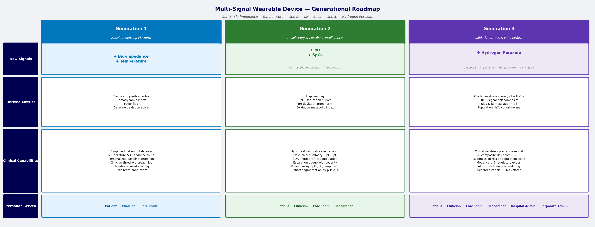
APPENDIX
Appendix C: Generational Capability Roadmap
The generational roadmap defines three capability releases tied to signal activation. Gen 1 activates Bio-impedance and Temperature with threshold alerting. Gen 2 adds pH and SpO₂, enabling AI risk scoring, LLM summaries, and EMR embedding. Gen 3 activates Hydrogen Peroxide, completing the full 6-signal composite risk model and enabling population-scale analytics. This phased approach reduces clinical validation scope per release.

Slide 15
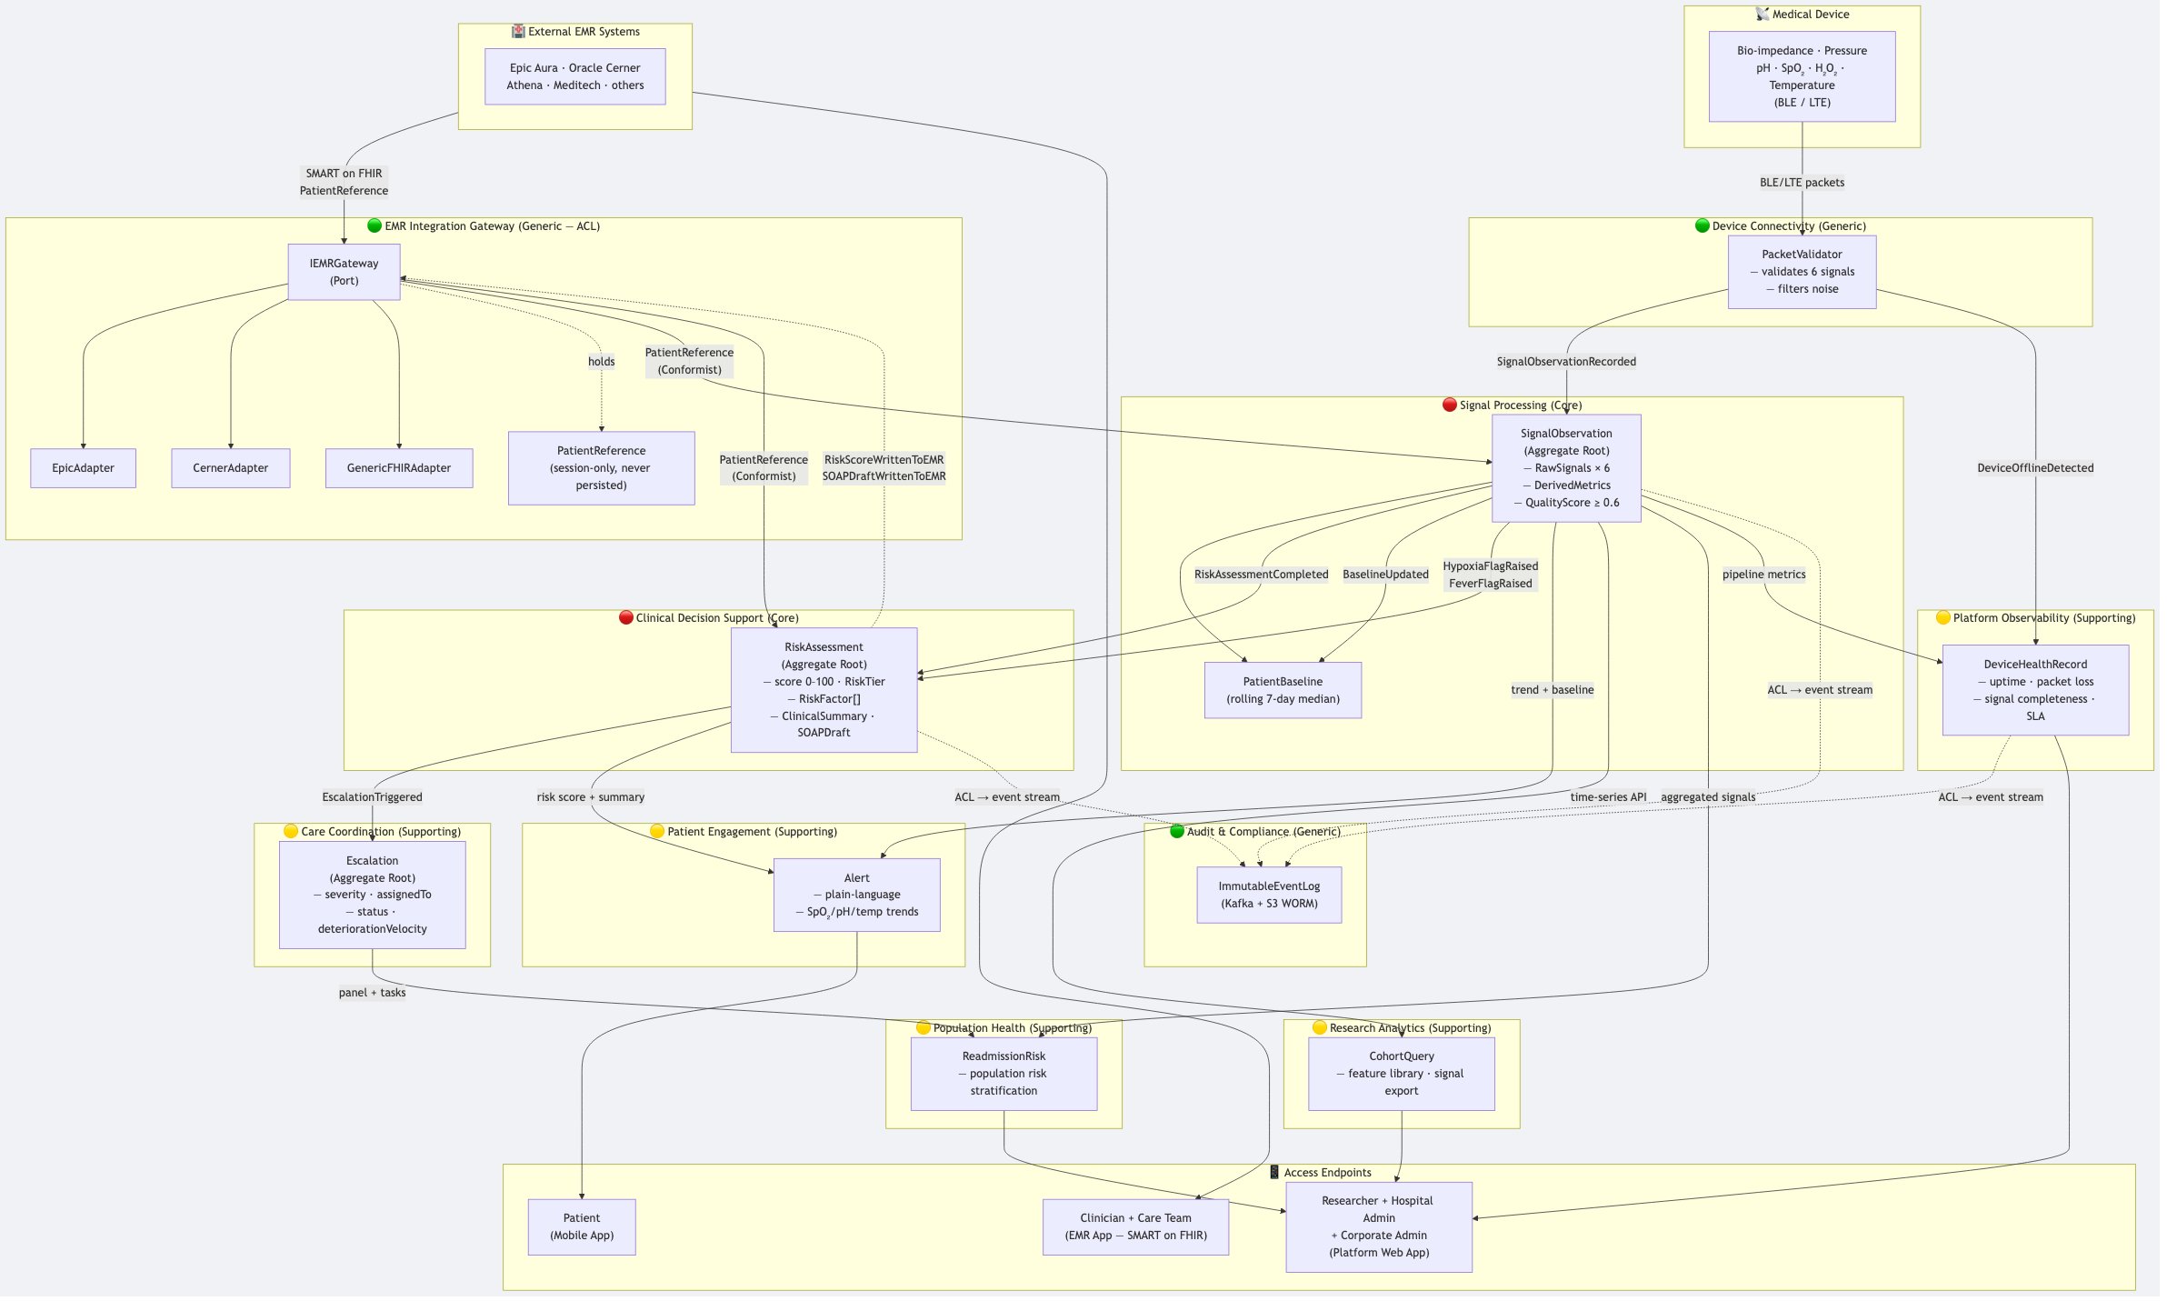
APPENDIX
Appendix D: Domain Map — Bounded Contexts
The domain map shows all eleven bounded contexts classified as Core (Signal Processing, Clinical Decision Support), Supporting (Patient Engagement, Care Coordination, Research Analytics, Population Health, Platform Observability), and Generic (Device Connectivity, Device Identity & Binding, Audit & Compliance, EMR Integration Gateway). Arrows show domain event flow and relationship patterns (Customer-Supplier, Published Language, ACL, Open Host Service).

Slide 16
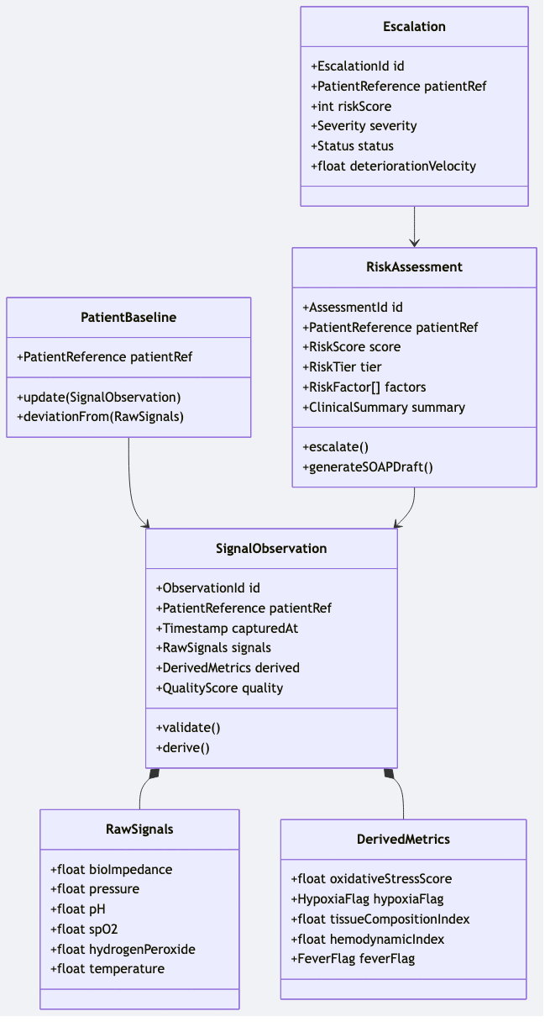
APPENDIX
Appendix E: Aggregate Design
The aggregate diagram shows the internal structure of the three primary aggregates: SignalObservation (raw signals + derived metrics + quality score), RiskAssessment (risk score + factors + LLM clinical summary), and DevicePatientBinding (serial number → HMAC token + EMR vendor + status). Each aggregate enforces its own invariants and is the single unit of consistency within its bounded context.

Slide 17
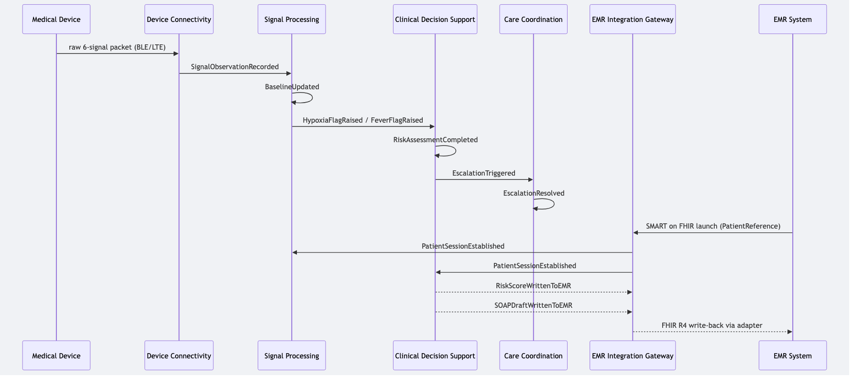
APPENDIX
Appendix F: Domain Events Sequence
The sequence diagram traces the end-to-end event flow from device signal transmission through to EMR write-back. Key events include: SignalObservationRecorded (triggers CDS), RiskAssessmentCompleted (triggers escalation and patient alert), EscalationTriggered (notifies care team), and RiskScoreWrittenToEMR / SOAPDraftWrittenToEMR (FHIR write-back via EMR adapter). All events are simultaneously mirrored to the immutable Audit & Compliance event log.

Slide 18
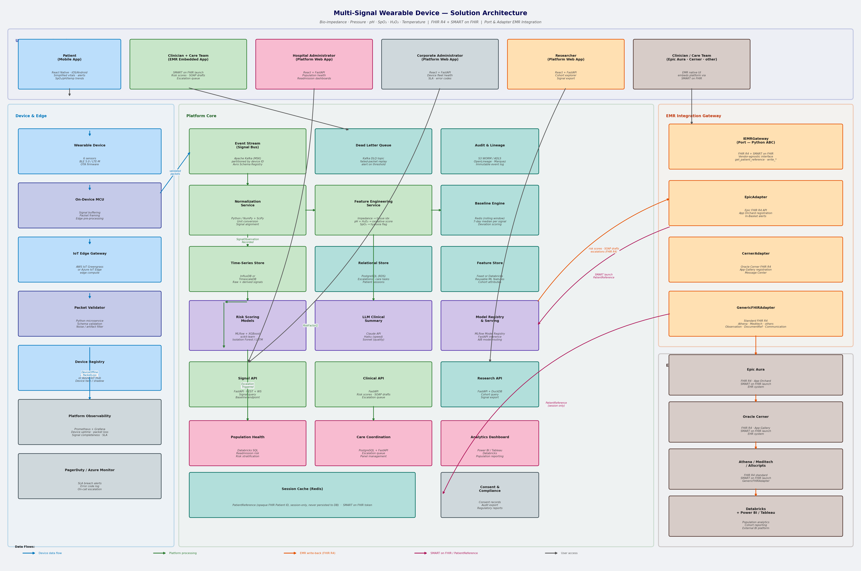
APPENDIX
Appendix G: Solution Architecture — Zone View
The solution architecture presents the platform as five deployment zones with explicit data flow arrows: Device Zone (wearable + edge gateway), Platform Zone (Kafka, microservices, ML), Integration Zone (IEMRGateway port + vendor adapters), Access Zone (web app, mobile app, EMR embedded UI), and Compliance Zone (WORM audit log, OpenLineage, consent store). Zone boundaries enforce security perimeters and data classification policies.

